Slide 1
MAJOR PROJECT
AICRUITER - AI VOICE AGENT INTERVIEW PLATFORM
Presented By,
Archi Prajapati
Hitanshu Purohit
Fiza Pathan
Mahi Prajapati
22000378
22000386
22000986
22000996

Slide 2



INTRODUCTION
Virtual assistants
In today's competitive job market, communication and interview skills are as vital as technical expertise.
The platform uses AI, NLP, and speech recognition to simulate real-time, human-like interviews.
Candidates engage with an AI interviewer that listens, asks relevant questions, and provides personalized feedback on clarity, tone, and content.
Organizations and academic institutions benefit from efficient, unbiased candidate screening.
The system uses modular architecture and AI-driven analytics to enhance career preparation.
Response Analysis
Instant Feedback
Personalized

Slide 3


BRIDGING THE GAP
Scope
Problem
Objective
Develop an AI-powered voice-based interview platform for realistic interview simulations using AI and speech technologies.
Existing tools lack voice interactivity and real interview pressure simulation, leading to poor candidate preparation.
Create an intelligent system that conducts voice interviews, analyzes responses, and provides instant feedback to improve candidate performance and reduce manual screening.

Slide 4
WHY AI VOICE AGENTS?
TRADITIONAL CHALLENGES
Traditional mock interviews require significant time and human involvement.
Organizations spend excessive resources on initial screening rounds.
Effective communication and interview confidence are critical for career success yet difficult to gain.
AI-DRIVEN SOLUTIONS
AI advances enable human-like conversational systems for interview practice, helping reduce anxiety and improve skills.
The project bridges the gap between theoretical knowledge and practical communication skills.
It offers an easily accessible, voice-based system for practice and efficient screening.

Slide 5
LITERATURE REVIEW
Review of existing platforms
PLATFORM | MERITS | DEMERITS
Grow with Google | Free tool, practice questions, transcribed answers | Lacks AI-based question generation and adaptive interaction
AIApply | Generates tailored questions based on job descriptions | Minimal conversational or adaptive interactioN
SmallTalk2Me | Analyzes 30+ parameters (fluency, grammar, confidence) | Focuses on language/fluency, not behavioral/technical prep
InterviewAI | Mobile app, voice-based mock interviews, instant feedback | Limited analytical depth and lacks adaptive follow-up questioning

Slide 6











STAKEHOLDERS
Academic Institutions
Job Seekers
Integrate for placement preparation and skill development.
Practice interviews, receive feedback, gain confidence.
Recruiters & HR
Automate screening, standardize evaluations.
Mentors
Monitor student progress and ensure ethical standards are maintained.
Developers
Build, integrate, and maintain backend, frontend, and AI feedback systems.

Slide 7
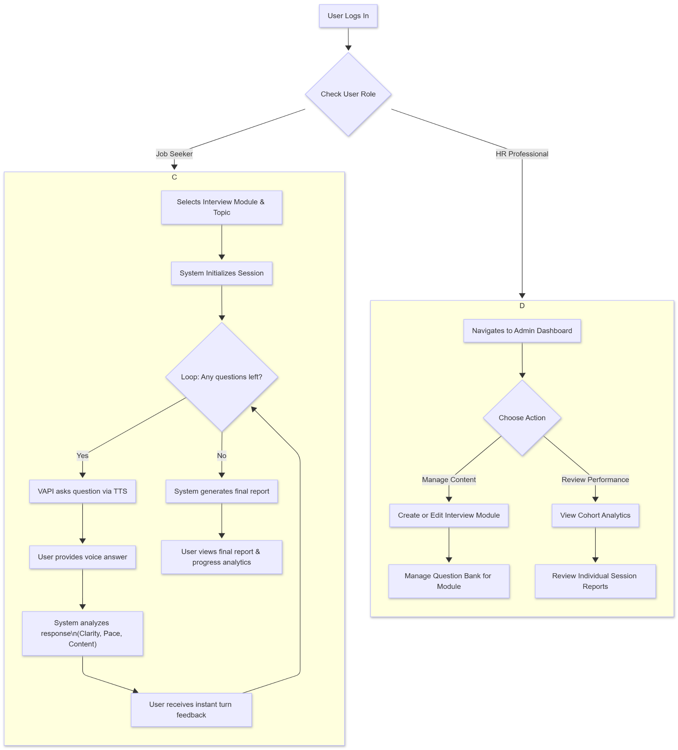
System Workflow

Slide 8



SYSTEM REQUIREMENTS
Hardware Requirements
Processor ( Intel Core i5+)
Robust hardware ensures reliable operation for model training and real-time voice processing.
RAM (8-16 GB )
Storage (SSD with 256 GB)
Graphics (discrete GPU)
Software Requirements
Programming (Python 3.9+)
Core Frameworks (TensorFlow)
The platform relies on a modern tech stack for seamless integration and deployment.
Database & Cloud (Firebase)
Deployment (AWS, Google Cloud)

Slide 9
APPROACH
USED
Combination of these empowers efficient development of an interactive, AI-driven interview application.
Technology Stack: Next.js, React, TailwindCSS, Python, Vapi.ai, Firebase.
Modular development with parallel frontend/backend work.
Agile iterative testing and feedback incorporation.
Cloud deployment with continuous enhancement planning.

Slide 10
CHALLENGES FACED AND SOLUTIONS
This introduces the key technical and operational challenges faced during the development of the AI Voice Agent Interview Platform and highlights the effective solutions implemented to overcome them.
1.
2.
3.
4.
Voice recognition accuracy improved via Vapi.ai and noise cancellation.
Ensured real-time responses despite network delays by asynchronous API calls and caching.
Dynamic question generation tailored by metadata tagging and AI prompts.
Delivered clear feedback with structured reports and recommendations.

Slide 11
PROTOTYPE IMPLEMENTATION SCREENSHOT
– https://app.eraser.io/workspace/UPvCvAJeMHVWB950WKNU?origin=share

Slide 12
THANK YOU!

